Slide 1
Programming in Oracle with PL/SQL
Procedural
Language
Extension to
SQL

Slide 2
PL/SQL
Allows using general programming tools with SQL, for example: loops, conditions, functions, etc.
This allows a lot more freedom than general SQL.
We write PL/SQL code in a regular file, for example PL.sql, and load it with @PL in the sqlplus console.

Slide 3
PL/SQL Blocks
PL/SQL code is built of Blocks, with a unique structure.
There are two types of blocks in PL/SQL:
  Anonymous Blocks: have no name (like scripts)
    can be written and executed immediately in SQLPLUS
    can be used in a trigger
  2. Named Blocks:
    Procedures
    Functions

Slide 4
Anonymous Block Structure:
DECLARE (optional)
  /* Here you declare the variables you will use in this block */
BEGIN (mandatory)
  /* Here you define the executable statements (what the block DOES!)*/
EXCEPTION (optional)
  /* Here you define the actions that take place if an exception is thrown during the run of this block */
END; (mandatory)
/
A correct completion of a block will generate the following message:
PL/SQL procedure successfully completed
Always put a new line with only a / at the end of a block! (This tells Oracle to run the block)

Slide 5
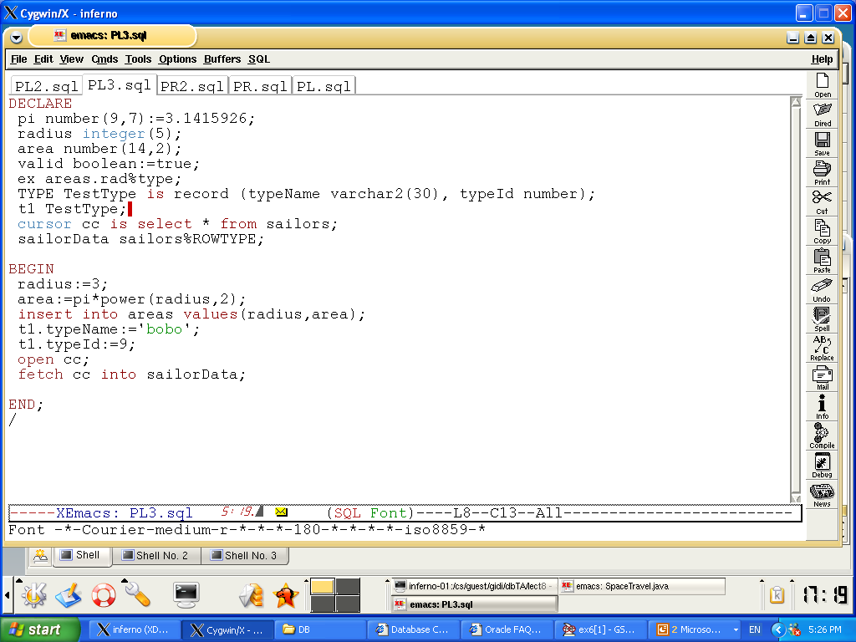

Slide 6
DECLARE
Syntax
Examples
identifier [CONSTANT] datatype [NOT NULL]
[:= | DEFAULT expr];
Notice that PL/SQL includes all SQL types, and more…
Declare
birthday DATE;
age NUMBER(2) NOT NULL := 27;
name VARCHAR2(13) := 'Levi';
magic CONSTANT NUMBER := 77;
valid BOOLEAN NOT NULL := TRUE;

Slide 7
Declaring Variables with the
%TYPE Attribute
Examples
Accessing column sname in table Sailors
DECLARE
sname Sailors.sname%TYPE;
fav_boat VARCHAR2(30);
my_fav_boat fav_boat%TYPE := 'Pinta';
...
Accessing another variable

Slide 8
Declaring Variables with the
%ROWTYPE Attribute
Declare a variable with the type of a ROW of a table.
And how do we access the fields in reserves_record?
Accessing table Reserves
reserves_record Reserves%ROWTYPE;
reserves_record.sid:=9;
Reserves_record.bid:=877;

Slide 9
Creating a PL/SQL Record
A record is a type of variable which we can define (like ‘struct’ in C or ‘object’ in Java)
DECLARE
TYPE sailor_record_type IS RECORD
(sname VARCHAR2(10),
sid VARCHAR2(9),
age NUMBER(3),
rating NUMBER(3));
sailor_record sailor_record_type;
...
BEGIN
Sailor_record.sname:=‘peter’;
Sailor_record.age:=45;
…

Slide 10
Creating a Cursor
We create a Cursor when we want to go over a result of a query (like ResultSet in JDBC)
Syntax Example:
DECLARE
cursor c is select * from sailors;
sailorData sailors%ROWTYPE;
BEGIN
open c;
fetch c into sailorData;
sailorData is a variable that can hold a ROW from the sailors table
Here the first row of sailors is inserted into sailorData

Slide 11
Example
DECLARE
Pi constant NUMBER(8,7) := 3.1415926;
area NUMBER(14,2);
cursor rad_cursor is select * from RAD_VALS;
rad_value rad_cursor%ROWTYPE;
BEGIN
open rad_cursor;
fetch rad_cursor into rad_val;
area:=pi*power(rad_val.radius,2);
insert into AREAS values (rad_val.radius, area);
close rad_cursor;
END;
/
RAD_VALS
radius
3
6
8
Rad_cursor
fetch
Rad_val
AREAS
Radius
Area
3
28.27

Slide 12
DECLARE
…
cursor rad_cursor is select * from RAD_VALS;
rad_value rad_cursor%ROWTYPE;
BEGIN
open rad_cursor;
fetch rad_cursor into rad_val;
area:=pi*power(rad_val.radius,2);
insert into AREAS values (rad_val.radius,
area);
…
DECLARE
…
cursor rad_cursor is select * from RAD_VALS;
rad_value RAD_VALS.radius%TYPE;
BEGIN
open rad_cursor;
fetch rad_cursor into rad_val;
area:=pi*power(rad_val,2);
insert into AREAS values (rad_val, area);
…
1
4
2
3
DECLARE
…
cursor rad_cursor is select * from RAD_VALS;
rad_value RAD_VALS%ROWTYPE;
BEGIN
open rad_cursor;
fetch rad_cursor into rad_val;
area:=pi*power(rad_val.radius,2);
insert into AREAS values (rad_val.radius, area);
…
DECLARE
…
cursor rad_cursor is select radius from
RAD_VALS;
rad_value RAD_VALS.radius%TYPE;
BEGIN
open rad_cursor;
fetch rad_cursor into rad_val;
area:=pi*power(rad_val,2);
insert into AREAS values (rad_val, area);
…

Slide 13
Explicit Cursor Attributes
Obtain status information about a cursor.
Attribute Type Description
%ISOPEN Boolean Evaluates to TRUE if the cursor is open.
%NOTFOUND Boolean Evaluates to TRUE if the most recent fetch does not return a row.
%FOUND Boolean Evaluates to TRUE if the most recent fetch returns a row; complement of %NOTFOUND
%ROWCOUNT Number Evaluates to the total number of rows returned so far.
Notes:
Explicit Cursor Attributes
As with implicit cursors, there are four attributes for obtaining status information about a cursor. When appended to the cursor or cursor variable, these attributes return useful information about the execution of a data manipulation statement.
Note: Do not reference cursor attributes directly in a SQL statement.

Slide 14
SELECT Statements
DECLARE
v_sname VARCHAR2(10);
v_rating NUMBER(3);
BEGIN
SELECT sname, rating
INTO v_sname, v_rating
FROM Sailors
WHERE sid = '112';
END;
/
INTO clause is required.
Query must return exactly one row.
Otherwise, a NO_DATA_FOUND or TOO_MANY_ROWS exception is thrown

Slide 15
Conditional logic
Condition:
Nested conditions:
If <cond>
then <command>
elsif <cond2>
then <command2>
else
<command3>
end if;
If <cond>
then
if <cond2>
then
<command1>
end if;
else <command2>
end if;

Slide 16
IF-THEN-ELSIF Statements
. . .
IF rating > 7 THEN
v_message := 'You are great';
ELSIF rating >= 5 THEN
v_message := 'Not bad';
ELSE
v_message := 'Pretty bad';
END IF;
. . .
Notes:
IF-THEN-ELSIF Statements
When possible, use the ELSIF clause instead of nesting IF statements. The code is easier to read and understand, and the logic is clearly identified. If the action in the ELSE clause consists purely of another IF statement, it is more convenient to use the ELSIF clause. This makes the code clearer by removing the need for nested END IFs at the end of each further set of conditions and actions.
Example
IF condition1 THEN
statement1;
ELSIF condition2 THEN
statement2;
ELSIF condition3 THEN
statement3;
END IF;
The example IF-THEN-ELSIF statement above is further defined as follows:
For a given value entered, return a calculated value. If the entered value is over 100, then the calculated value is two times the entered value. If the entered value is between 50 and 100, then the calculated value is 50% of the starting value. If the entered value is less than 50, then the calculated value is 10% of the starting value.
Note: Any arithmetic expression containing null values evaluates to null.

Slide 17
Suppose we have the following table:
create table mylog(
who varchar2(30),
logon_num number
);
mylog
who | logon_num
Peter | 3
John | 4
Moshe | 2
Want to keep track of how many times someone logged on to the DB
When running, if user is already in table, increment logon_num. Otherwise, insert user into table

Slide 18
Solution
DECLARE
cnt NUMBER;
BEGIN
select logon_num
into cnt
from mylog
where who = user;
if cnt > 0 then
update mylog
set logon_num = logon_num + 1
where who = user;
else
insert into mylog values(user, 1);
end if;
commit;
end;
/

Slide 19
SQL Cursor
SQL cursor is automatically created after each SQL query. It has 4 useful attributes:
SQL%ROWCOUNT Number of rows affected by the most recent SQL statement (an integer value).
SQL%FOUND Boolean attribute that evaluates to TRUE if the most recent SQL statement affects one or more rows.
SQL%NOTFOUND Boolean attribute that evaluates to TRUE if the most recent SQL statement does not affect any rows.
SQL%ISOPEN Always evaluates to FALSE because PL/SQL closes implicit cursors immediately after they are executed.
Notes:
SQL Cursor Attributes
SQL cursor attributes allow you to evaluate what happened when the implicit cursor was last used. You use these attributes in PL/SQL statements such as functions. You cannot use them in SQL statements.
You can use the attributes, SQL%ROWCOUNT, SQL%FOUND, SQL%NOTFOUND, and SQL%ISOPEN in the exception section of a block to gather information about the execution of a data manipulation statement. PL/SQL does not consider a DML statement that affects no rows to have failed, unlike the SELECT statement, which returns an exception.

Slide 20
Solution (2)
BEGIN
update mylog
set logon_num = logon_num + 1
where who = user;
if SQL%ROWCOUNT = 0 then
insert into mylog values(user, 1);
end if;
commit;
END;
/

Slide 21
Loops: Simple Loop
create table number_table(
num NUMBER(10)
);
DECLARE
i number_table.num%TYPE := 1;
BEGIN
LOOP
INSERT INTO number_table
VALUES(i);
i := i + 1;
EXIT WHEN i > 10;
END LOOP;
END;
Notes:
Basic Loop
The basic loop example shown in the slide is defined as follows: insert the first 10 new line items for order number 101.
Note: A basic loop allows execution of its statements at least once, even if the condition has been met upon entering the loop.

Slide 22
Loops: Simple Cursor Loop
create table number_table(
num NUMBER(10)
);
DECLARE
cursor c is select * from number_table;
cVal c%ROWTYPE;
BEGIN
open c;
LOOP
fetch c into cVal;
EXIT WHEN c%NOTFOUND;
insert into doubles values(cVal.num*2);
END LOOP;
END;
Notes:
Basic Loop
The basic loop example shown in the slide is defined as follows: insert the first 10 new line items for order number 101.
Note: A basic loop allows execution of its statements at least once, even if the condition has been met upon entering the loop.

Slide 23
Loops: FOR Loop
DECLARE
i number_table.num%TYPE;
BEGIN
FOR i IN 1..10 LOOP
INSERT INTO number_table VALUES(i);
END LOOP;
END;
Notice that i is incremented automatically

Slide 24
Loops: For Cursor Loops
DECLARE
cursor c is select * from number_table;
BEGIN
for num_row in c loop
insert into doubles_table
values(num_row.num*2);
end loop;
END;
/
Notice that a lot is being done implicitly: declaration of num_row, open cursor, fetch cursor, the exit condition
Notes:
Cursor FOR Loops
A cursor FOR loop processes rows in an explicit cursor. The cursor is opened, rows are fetched once for each iteration in the loop, and the cursor is closed automatically when all rows have ben processed. The loop itself is terminated automatically at the end of the iteration where the last row was fetched.

Slide 25
Loops: WHILE Loop
DECLARE
TEN number:=10;
i number_table.num%TYPE:=1;
BEGIN
WHILE i <= TEN LOOP
INSERT INTO number_table
VALUES(i);
i := i + 1;
END LOOP;
END;
Notes:
WHILE Loop
In the example in the slide, the quantity increases with each iteration of the loop until the quantity is no longer less than the maximum price allowed for spending on the item.

Slide 26
Printing Output
You need to use a function in the DBMS_OUTPUT package in order to print to the output
If you want to see the output on the screen, you must type the following (before starting):
  set serveroutput on format wrapped size 1000000
Then print using
  dbms_output. put_line(your_string);
  dbms_output.put(your_string);

Slide 27
Input and output example
set serveroutput on format wrap size 1000000
ACCEPT high PROMPT 'Enter a number: '
DECLARE
i number_table.num%TYPE:=1;
BEGIN
dbms_output.put_line('Look Ma, I can print from PL/SQL!!!');
WHILE i <= &high LOOP
INSERT INTO number_table
VALUES(i);
i := i + 1;
END LOOP;
END;

Slide 28
Reminder- structure of a block
DECLARE (optional)
  /* Here you declare the variables you will use in this block */
BEGIN (mandatory)
  /* Here you define the executable statements (what the block DOES!)*/
EXCEPTION (optional)
  /* Here you define the actions that take place if an exception is thrown during the run of this block */
END; (mandatory)
/

Slide 29
Trapping Exceptions
Here we define the actions that should happen when an exception is thrown.
Example Exceptions:
  NO_DATA_FOUND
  TOO_MANY_ROWS
  ZERO_DIVIDE
When handling an exception, consider performing a rollback
Notes:
Trapping Predefined Oracle Server Errors
Trap a predefined Oracle Server error by referencing its standard name within the corresponding exception-handling routine.
Note: PL/SQL declares predefined exceptions in the STANDARD package.
It is a good idea to always consider the NO_DATA_FOUND and TOO_MANY_ROWS exceptions, which are the most common.

Slide 30
DECLARE
num_row number_table%ROWTYPE;
BEGIN
select *
into num_row
from number_table;
dbms_output.put_line(1/num_row.num);
EXCEPTION
WHEN NO_DATA_FOUND THEN
dbms_output.put_line('No data!');
WHEN TOO_MANY_ROWS THEN
dbms_output.put_line('Too many!');
WHEN OTHERS THEN
dbms_output.put_line(‘Error’);
end;
Notes:
Trapping Predefined Oracle Server Exceptions
In the slide example for each exception, a message is printed out to the user.
Only one exception is raised and handled at any time.

Slide 31
User-Defined Exception
DECLARE
e_number1 EXCEPTION;
cnt NUMBER;
BEGIN
select count(*)
into cnt
from number_table;
IF cnt = 1 THEN RAISE e_number1;
ELSE dbms_output.put_line(cnt);
END IF;
EXCEPTION
WHEN e_number1 THEN
dbms_output.put_line('Count = 1');
end;
Notes:
Trapping User-Defined Exceptions
You trap a user-defined exception by declaring it and raising it explicitly.
1. Declare the name for the user-defined exception within the declarative section.
Syntax
exception EXCEPTION;
where: exception is the name of the exception.
2. Use the RAISE statement to raise the exception explicitly within the executable section.
Syntax
RAISE exception;
where: exception is the previously declared exception.
3. Reference the declared exception within the corresponding exception handling routine.
In the slide example: This customer has a business rule that states a that a product can not be removed from its database if there is any inventory left in-stock for this product. As there are no constraints in place to enforce this rule, the developer handles it explicitly in the application. Before performing a DELETE on the PRODUCT table, the block queries the INVENTORY table to see if there is any stock for the product in question. If so, raise an exception.
Note: Use the RAISE statement by itself within an exception handler to raise the same exception back to the calling environment.

Slide 32
Functions and Procedures
Up until now, our code was in an anonymous block
It was run immediately
It is useful to put code in a function or procedure so it can be called several times
Once we create a procedure or function in a Database, it will remain until deleted (like a table).

Slide 33
Creating Procedures
CREATE [OR REPLACE] PROCEDURE procedure_name
[(parameter1 [mode1] datatype1,
parameter2 [mode2] datatype2,
. . .)]
IS|AS
PL/SQL Block;
Modes:
  IN: procedure must be called with a value for the parameter. Value cannot be changed
  OUT: procedure must be called with a variable for the parameter. Changes to the parameter are seen by the user (i.e., call by reference)
  IN OUT: value can be sent, and changes to the parameter are seen by the user
Default Mode is: IN

Slide 34
Example- what does this do?
Table mylog
create or replace procedure
num_logged
(person IN mylog.who%TYPE,
num OUT mylog.logon_num%TYPE)
IS
BEGIN
select logon_num
into num
from mylog
where who = person;
END;
/
who | logon_ num
Pete | 3
John | 4
Joe | 2

Slide 35
Calling the Procedure
declare
howmany mylog.logon_num%TYPE;
begin
num_logged(‘John',howmany);
dbms_output.put_line(howmany);
end;
/

Slide 36
Errors in a Procedure
When creating the procedure, if there are errors in its definition, they will not be shown
To see the errors of a procedure called myProcedure, type
  SHOW ERRORS PROCEDURE myProcedure
in the SQLPLUS prompt
For functions, type
  SHOW ERRORS FUNCTION myFunction

Slide 37
Creating a Function
Almost exactly like creating a procedure, but you supply a return type
CREATE [OR REPLACE] FUNCTION
function_name
[(parameter1 [mode1] datatype1,
parameter2 [mode2] datatype2,
. . .)]
RETURN datatype
IS|AS
PL/SQL Block;

Slide 38
A Function
create or replace function
rating_message(rating IN NUMBER)
return VARCHAR2
AS
BEGIN
IF rating > 7 THEN
return 'You are great';
ELSIF rating >= 5 THEN
return 'Not bad';
ELSE
return 'Pretty bad';
END IF;
END;
/
NOTE THAT YOU DON'T SPECIFY THE SIZE

Slide 39
Calling the function
declare
paulRate:=9;
Begin dbms_output.put_line(ratingMessage(paulRate));
end;
/

Slide 40
Packages
Functions, Procedures, Variables can be put together in a package
In a package, you can allow some of the members to be "public" and some to be "private"
There are also many predefined Oracle packages
Won't discuss packages in this course

Slide 41
Triggers
Triggers are special procedures which we want activated when someone has performed some action on the DB.
For example, we might define a trigger that is executed when someone attempts to insert a row into a table, and the trigger checks that the inserted data is valid.

Slide 42
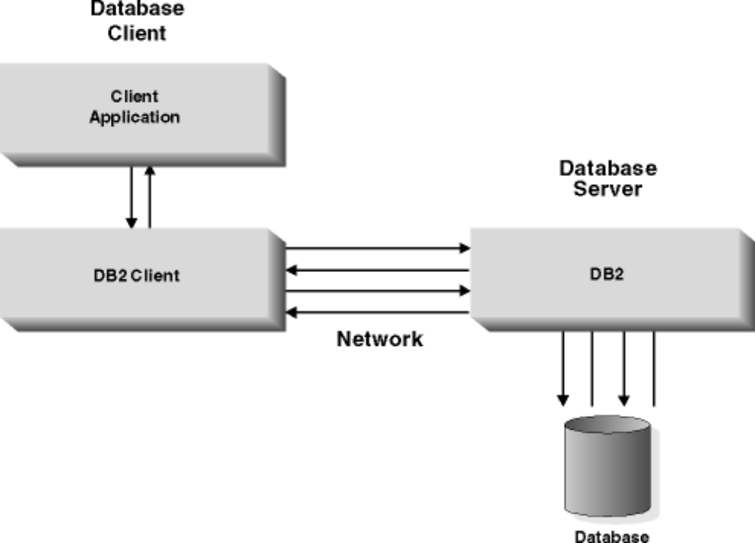
Normal Database

Slide 43
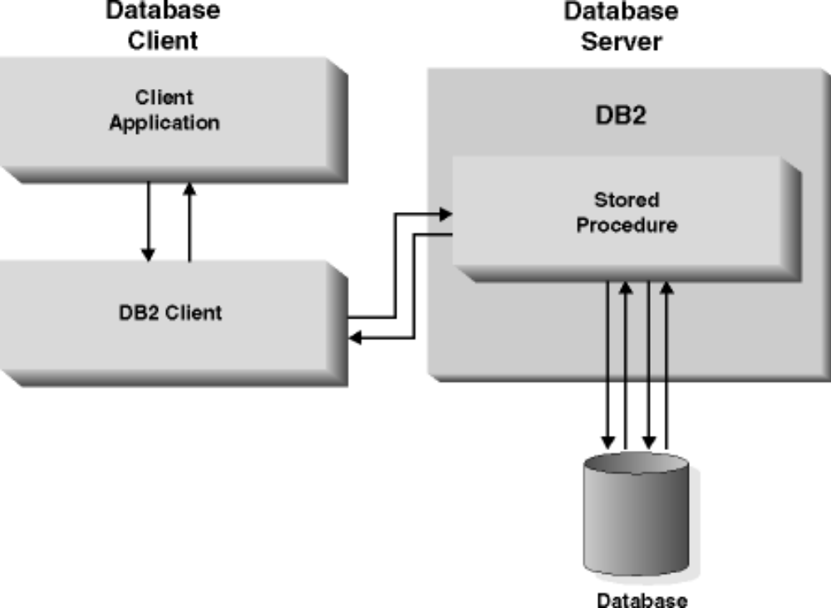
Applications using stored procedures

